Slide 1

NYC WEATHER ANALYSIS
TITLE
CREATED BY
OJIRIKA JOHN OJIRIKA
30/06/2026

Slide 2

TABLE OF CONTENTS
Introduction
2. Loading/reading the CSV file
3. Data Cleaning
4. Exploratory Data Analysis EDA
5. Summary
6. Conclusion

Slide 3


INTRODUCTION
To highlight the highest and lowest values in the dataset.
To explain the reasons behind these extremes.
Identifying peaks shows strengths and opportunities.
Recognizing lows highlights challenges and areas for improvement.
The goal: build strong foundations in Python programming and apply them to real-world problems.

Slide 4
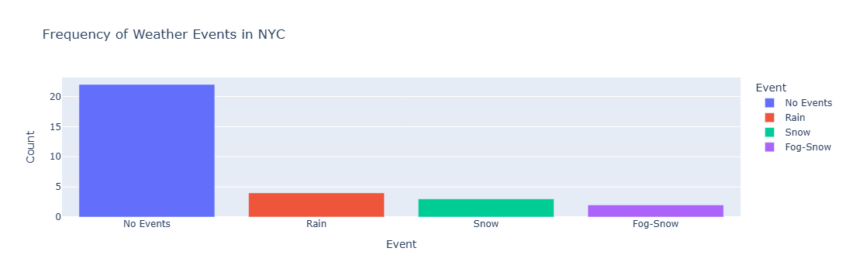
FREQUENCY OF WEATHER EVENTS IN NYC
Interactive bar chart showing how many days had Rain, Snow, Fog-Snow, or No Events, and which events dominate (e.g., more Rain days vs. Snow days).
From the frequency, it shows that most of the time there are no events, and there are more Rain days than Snow days, as shown below
No Events (blue bar) is above 20 occurrences — by far the most frequent category.
Rain (orange bar): Around 4 occurrences.
Snow (green bar): Around 3 occurrences.
Fog-Snow (purple bar): Around 2 occurrences.
Summary
The chat shows that most of the time, there are no events; From the chat observations, it counts significantly higher than others. Rain and snow occur occasionally, while fog-snow is the least frequent and occurs much less frequently

Slide 5
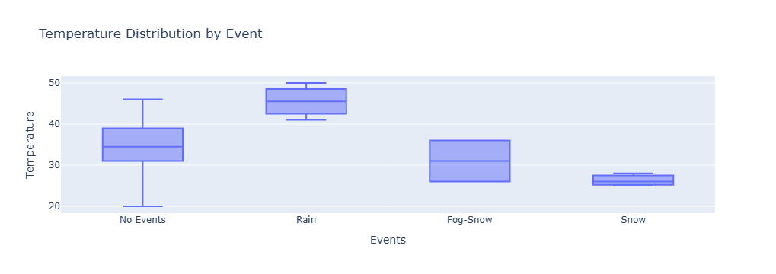
THIS SHOWS HOW TEMPERATURES VARY DEPENDING ON WHETHER IT WAS RAIN, SNOW, FOG-SNOW, OR NO EVENTS.
Highest temperatures: Rain → clustered around 45–50, the warmest range.
Lowest temperatures: Snow → tightly grouped around 25–28, the coldest range.
Other ranges:
No Events → broad spread from about 20–45, showing the widest variability.
Fog-Snow → moderate range around 25–35.
Summary
The chart shows that rainy conditions are associated with the highest temperatures, while snowy conditions correspond to the lowest and most stable temperatures. Fog-snow sits in between, and periods with no events display the greatest variability, spanning both cooler and warmer ranges. Overall, the data highlights how different weather events strongly influence temperature patterns, with rain linked to warmth and snow linked to cold stability.

Slide 6

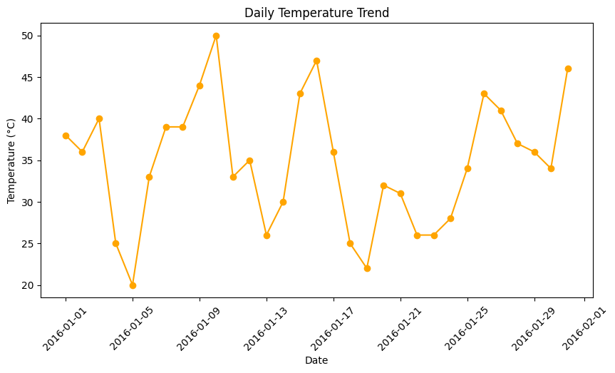
TEMPERATURE TRENDS
Highest temperature: Peaks close to 50 °C during the period.
Lowest temperature: Drops near 20 °C.
The data shows significant fluctuations day to day.
Summary
The daily temperature trend between early January and early February 2016 shows large swings, ranging from very warm days around 50 °C to cooler days near 20 °C. The pattern highlights strong variability rather than a steady progression, suggesting alternating hot and mild conditions over the month.

Slide 7

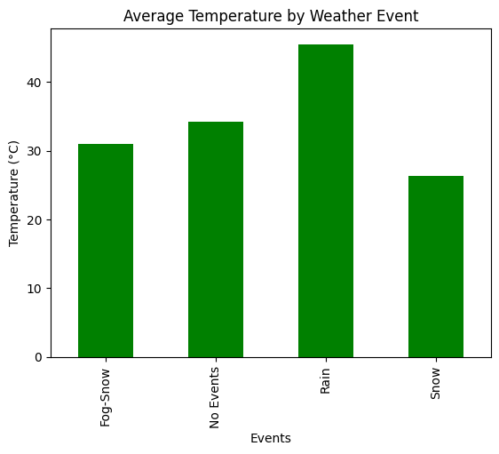
AVERAGE TEMPERATURE FOR EACH WEATHER EVENT
MEAN
Events
Fog-Snow 31.000000
No Events 34.181818
Rain 45.500000
Snow 26.333333
Name: Temperature
Highest average temperature: Rain → about 45.5 °C.
Lowest average temperature: Snow → about 26.3 °C.
Other values:
No Events → around 34.2 °C.
Fog-Snow → about 31 °C.
Summary
From the chart, it shows that rainy conditions are linked to the warmest average temperatures, while snowy conditions correspond to the coldest averages. Fog-snow and no events fall in between, with moderate temperatures. Overall, the data highlights a strong relationship between weather type and temperature, where precipitation in the form of rain tends to occur during warmer periods, and snow during colder ones.

Slide 8

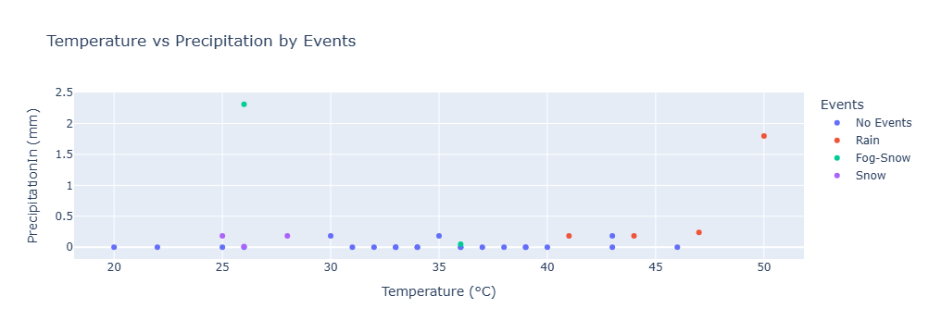
INTERACTIVE SCATTER PLOT: TEMPERATURE VS PRECIPITATION
Highest precipitation: A Fog-Snow event at about 26 °C with 2.3 mm precipitation — the standout point on the chart.
Lowest precipitation: Most events, especially No Events and Rain, cluster near 0 mm, showing little to no precipitation.
Temperature range: Points span roughly 18 °C to 52 °C, with rain events tending toward the warmer end.
Summary
The scatter plot shows that precipitation is generally minimal across all events, with one notable fog-snow case producing the highest recorded precipitation. Rain events occur at higher temperatures but with little precipitation, while snow and fog-snow cluster in cooler ranges. Overall, the chart highlights that precipitation is rare and usually light, except for occasional fog-snow spikes.

Slide 9

SUMMARY OF NYC WEATHER ANALYSIS
The project uses Python modules like Pandas, Numpy, matplotlib, seaborn and plotly and functions for data handling, cleaning, statistical analysis and visualization. It focuses on exploring NYC weather data, identifying extremes, and understanding how different weather events influence temperature and precipitation patterns.
NYC weather is dominated by days with no events, followed by occasional rain and snow.
Rain is consistently associated with warmer temperatures, while snow marks the coldest and most stable conditions.
Fog-Snow is rare but produces the highest precipitation spikes.
Overall, the dataset highlights strong variability in NYC’s winter weather, with alternating warm and cold days and precipitation generally being light.

Slide 10

CONCLUSION
The analysis demonstrates that weather events in NYC strongly influence temperature and precipitation patterns.
No Events dominate the dataset, showing the city often experiences calm days without notable weather activity.
Rain consistently aligns with the warmest temperatures, while Snow corresponds to the coldest and most stable conditions.
Fog-Snow, though rare, produces the highest precipitation spikes, highlighting its unique impact compared to other events.
Overall, the data reveals high variability in daily temperatures (ranging from ~20 °C to ~50 °C), with alternating warm and cold days rather than a steady seasonal trend.
Important Key
I understand how I can use Python to analyze weather data, understand patterns and extremes, also showcasing how Python can be applied to real-world datasets for meaningful insights.

